Slide 1
MicroServices

Slide 2
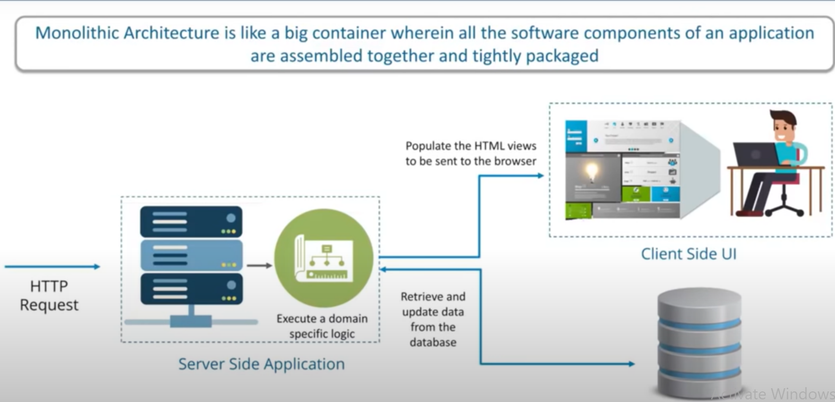
Monolithic Architecture

Slide 3
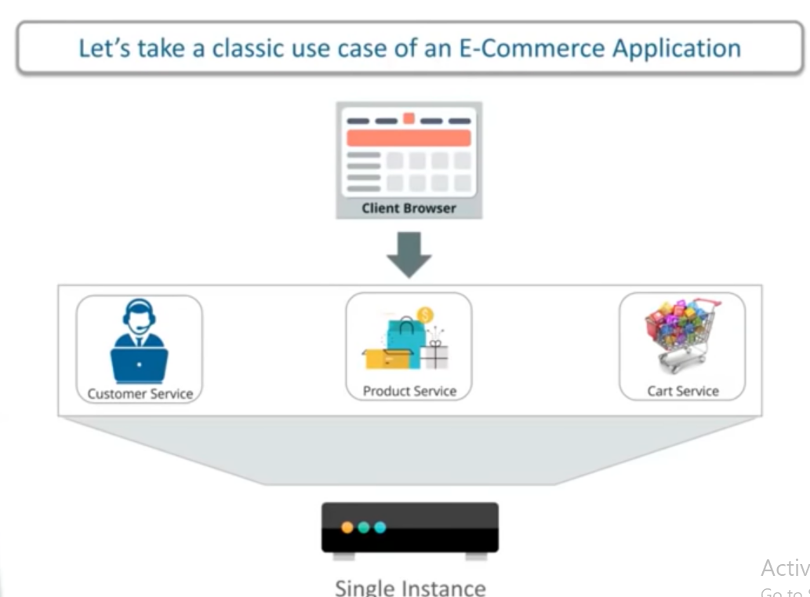
Monolithic Architecture

Slide 4
Disadvantages(Monolithic)
Large and complex applications
Slow development
Blocks continuous development
Unscalable
- have to scale with all services.
Unreliable
- one service goes down everything goes down.
Inflexible
- cannot be upgraded easily to new frameworks.

Slide 5
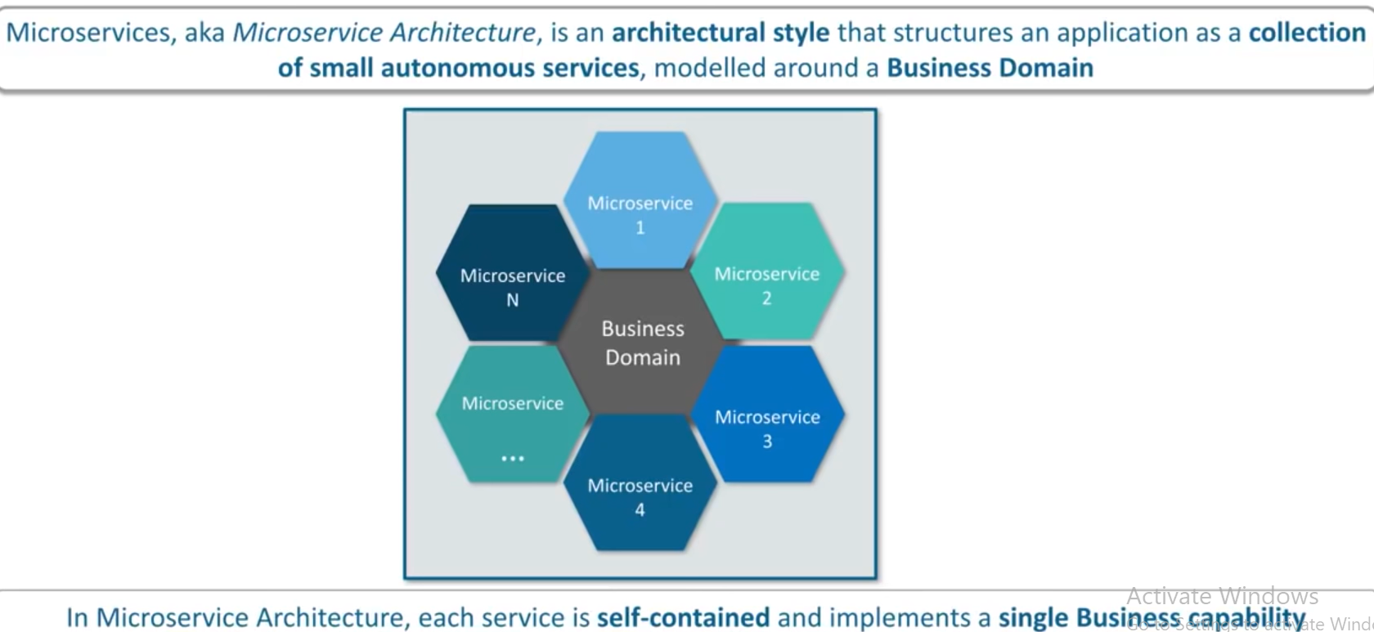
Microservices

Slide 6
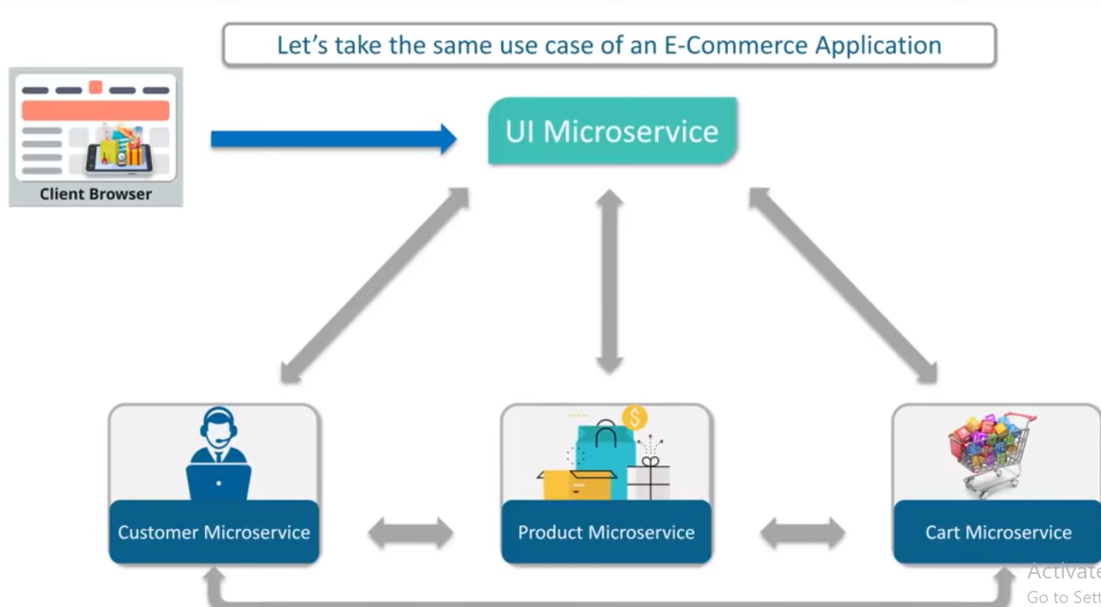
Microservice architecture example

Slide 7
Features of Microservices
Small focused
- tiny services.
Loosely coupled
- separate code for each service.
Language neutral
- services can be of different languages.
Bounded context
- no need for one service know the work of other service.

Slide 8
Advantages of Microservices
Independent development
Mixed technology stack
Independent deployment
Fault isolation
- only one service will go down not all.
Granular scaling
- services can be scaled independently.

Slide 9
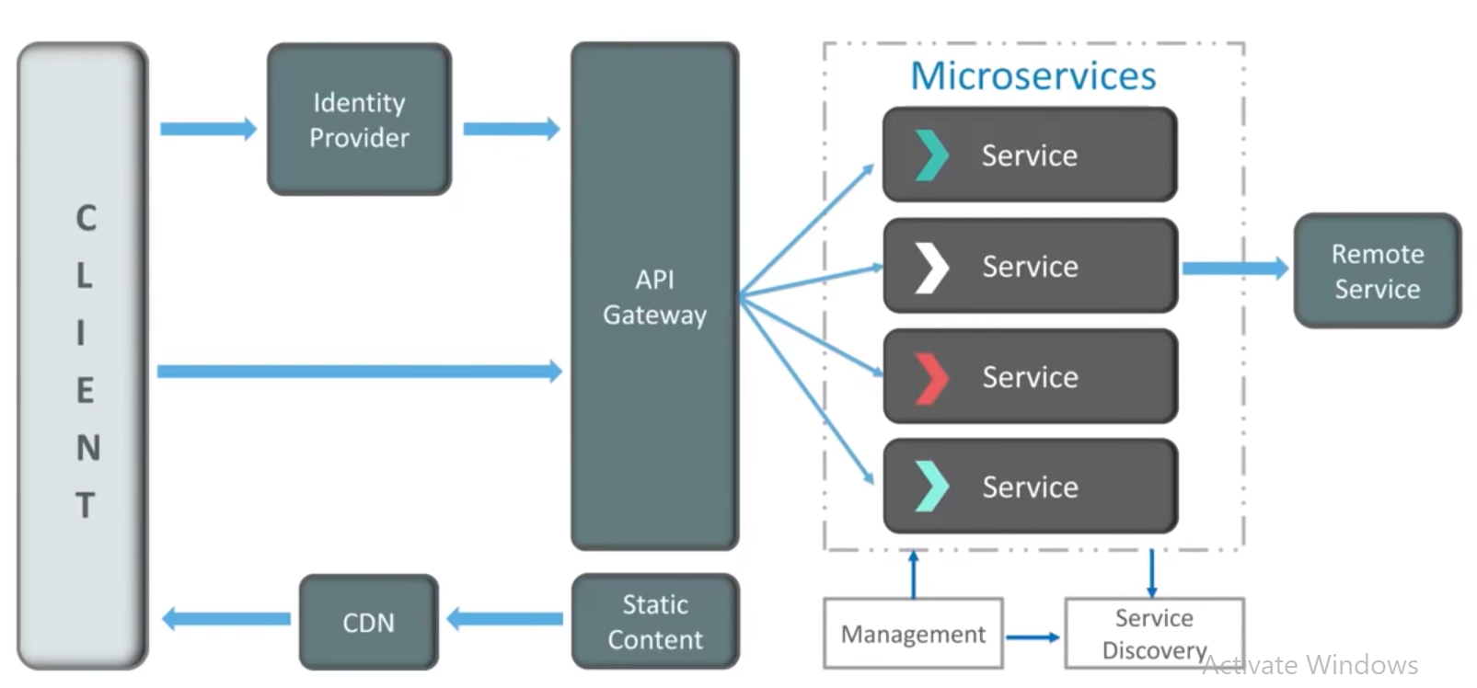
Microservice Architecture

Slide 10

Top Companies using Microservices

Slide 11
Steps to Create MS
Create service 1 (i.e department-service) and perform save and get operation
Create service 2 (i.e user-service) and perform save and get operation
Now get Service 2 with Service 1 for that use RestTemplate to get service 1 with POJO classes.
Create service 3 (i.e service-registry) use eureka server for register all the services
Configure service 3 along with service 1, 2 ..n for registering and managing all the services
Create service 4 (i.e api-gateway) to get all the service via common get way
Create service 5 (i.e config-server) for configure your all services and keep it to Git Repo.
Create Zipkin Server and sleuth for trace all your services and with trace and space id
Use circuit breaker with fallback method to break the chain in between services.
if any one service goes down other services shouldn’t get affected (fault isolation)

Slide 12
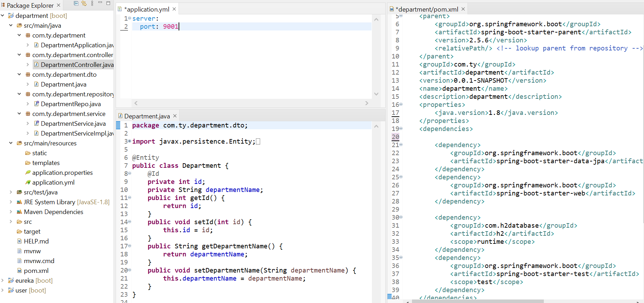
service 1 (pom.xml, application.yml, DTO class)

Slide 13
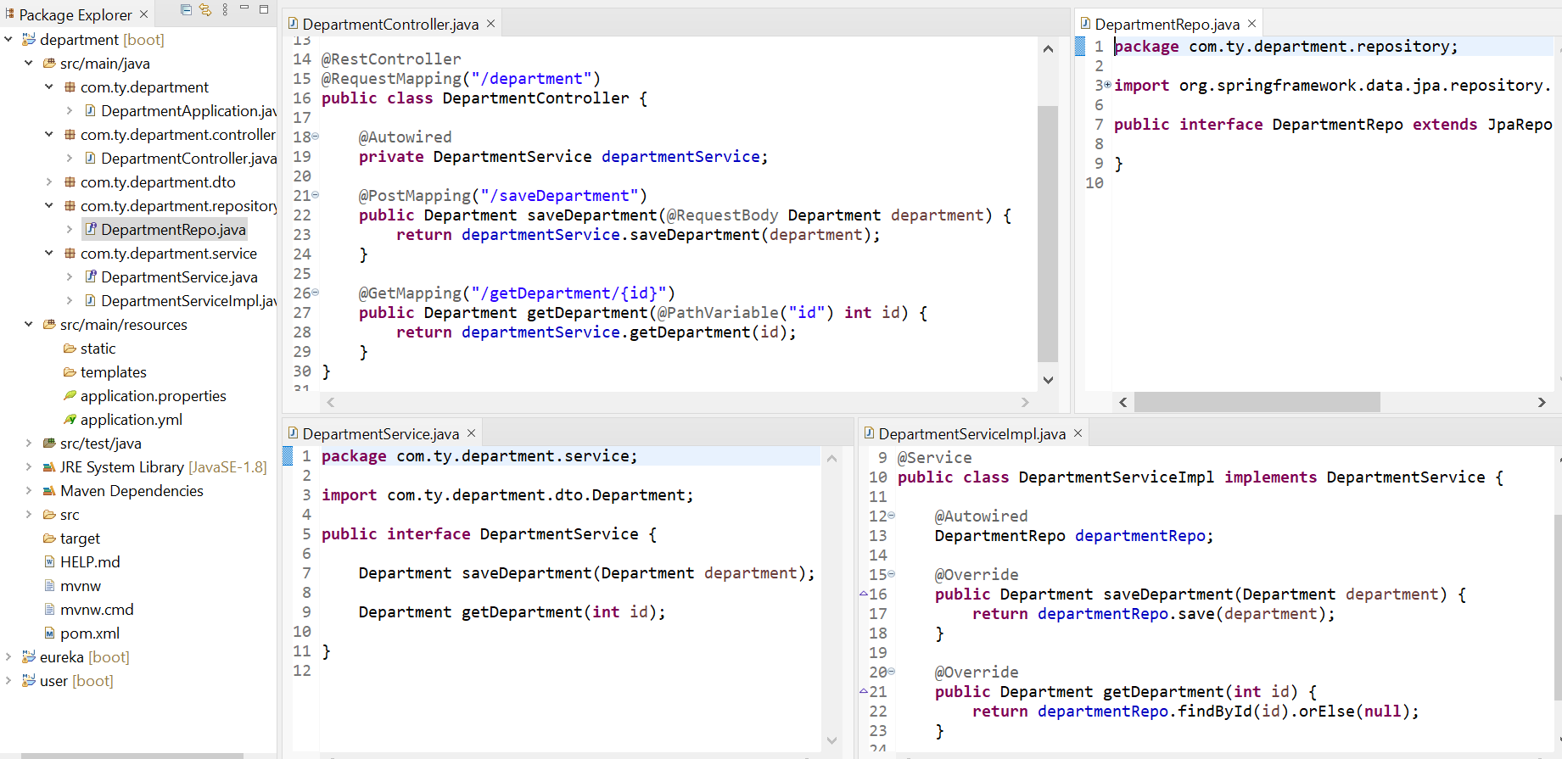
service 1 ( Controller, Service, Repository)

Slide 14
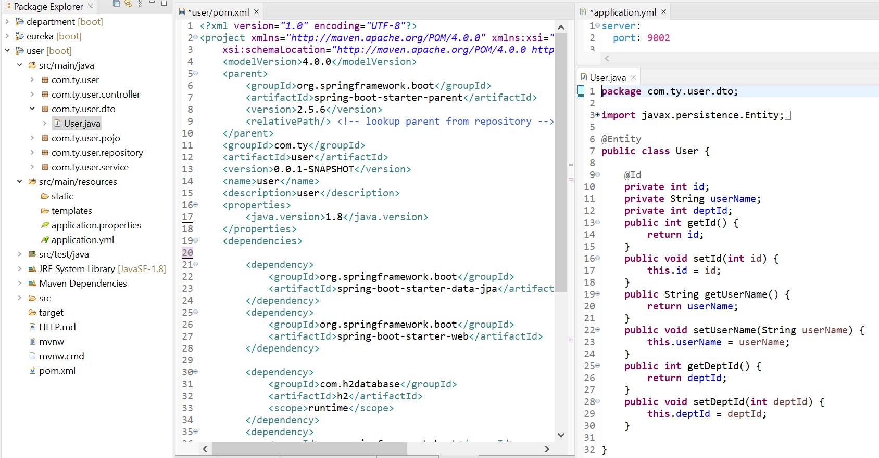
service 2 (pom.xml, application.yml, DTO class)

Slide 15
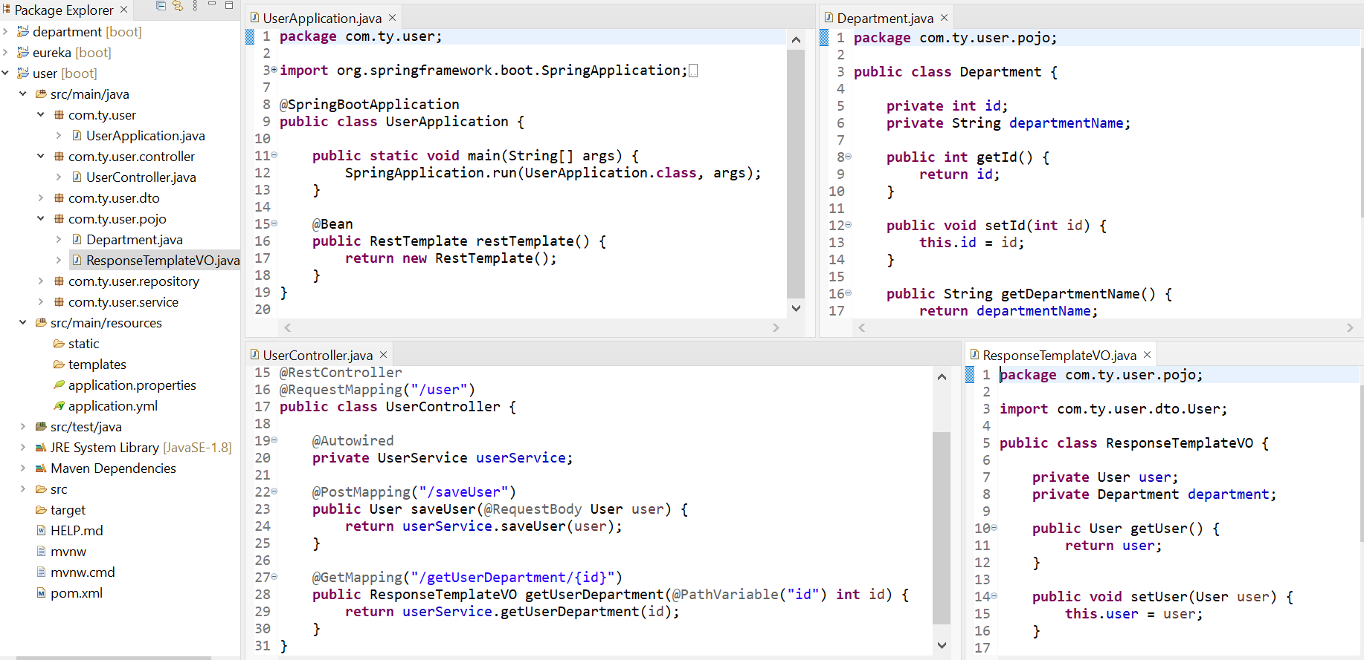
service 2 ( Application,Controller, Department, ReponseTemplateVO)

Slide 16
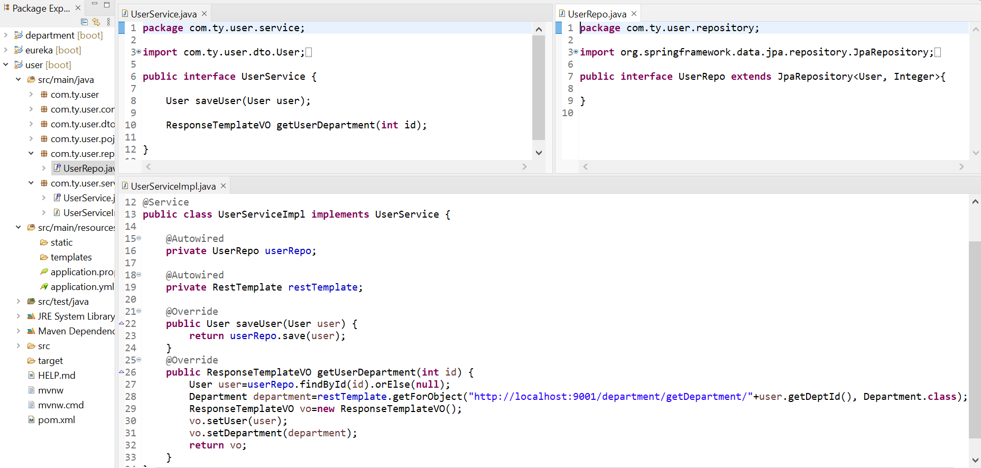
service 2 ( Service and Repository)

Slide 17
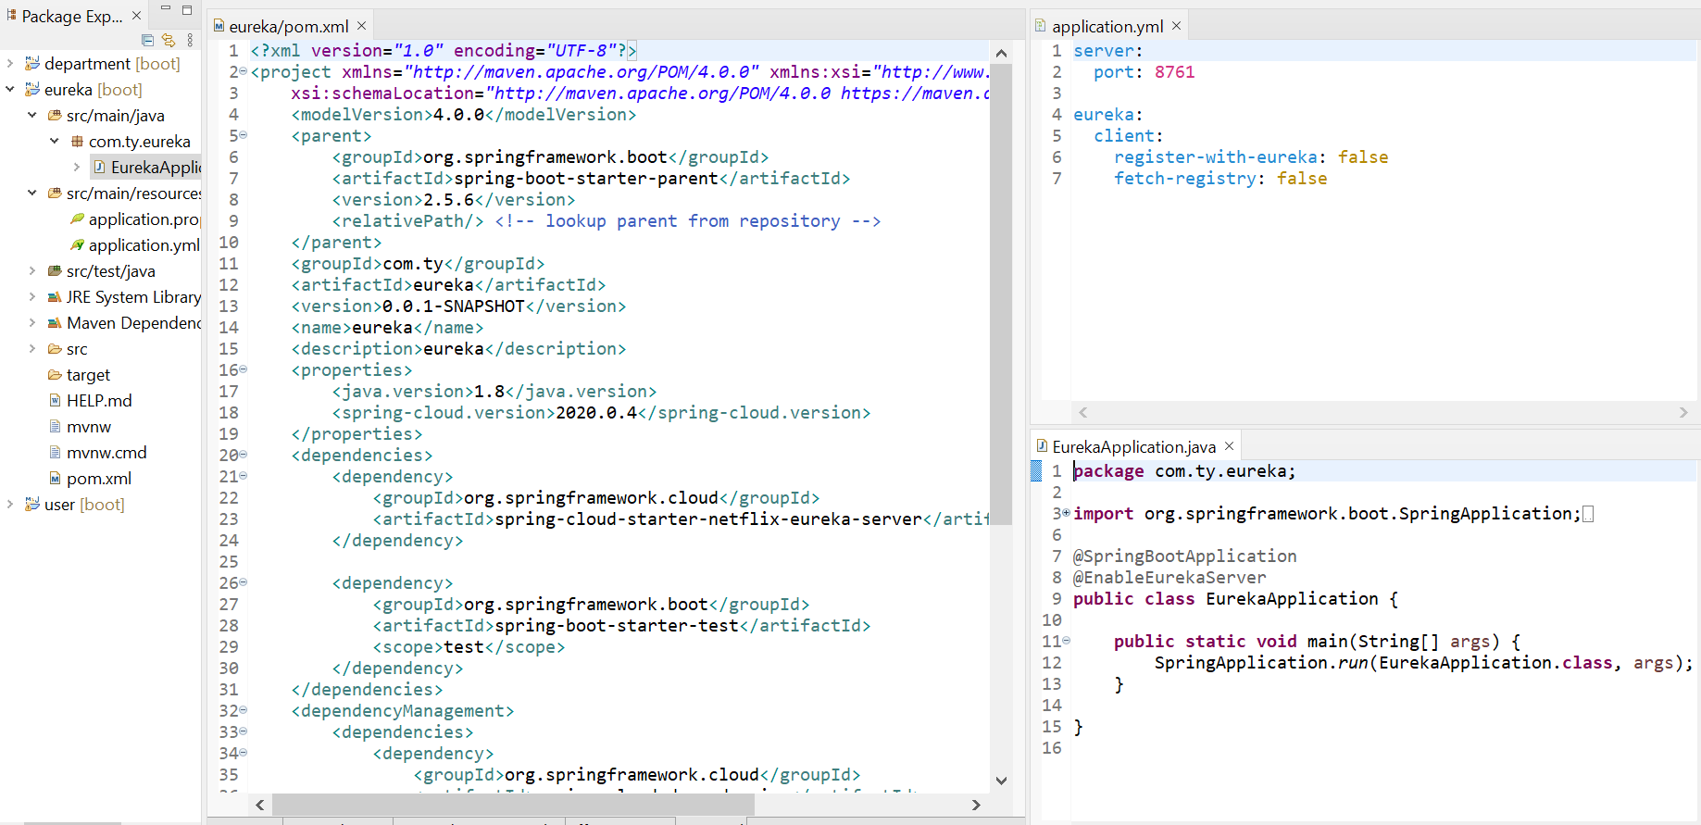
service 3 (service-registry) Eureka Server

Slide 18
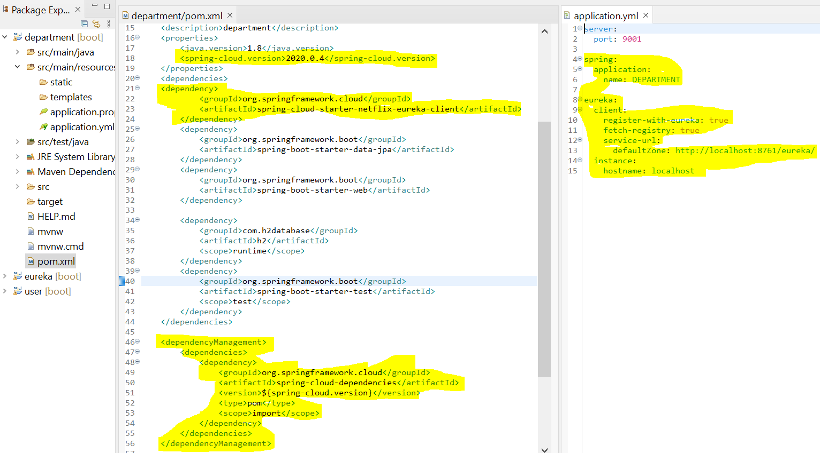
configure Service 1 with Eureka Server

Slide 19
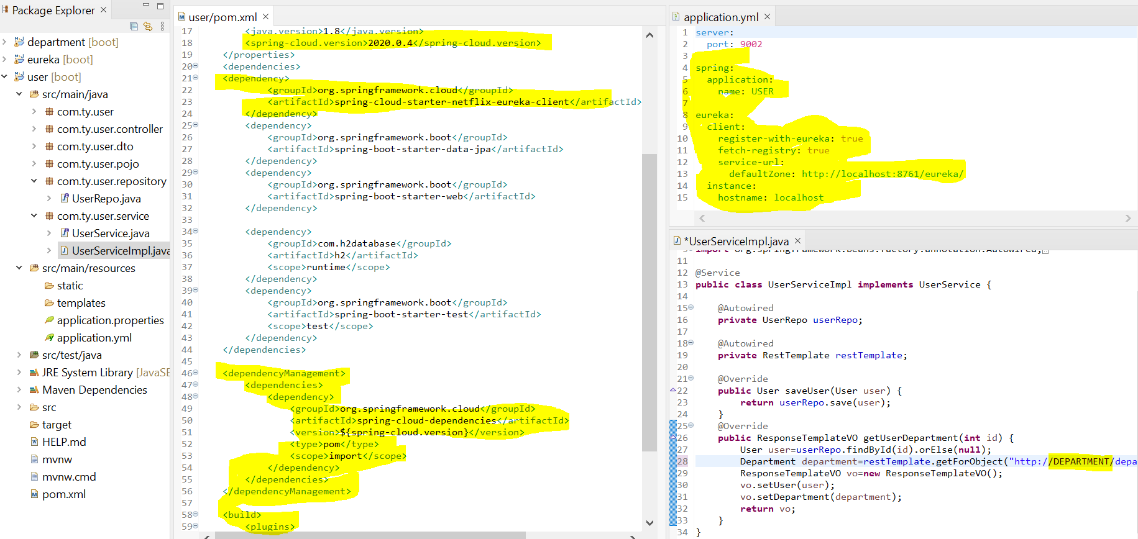
configure Service 2 with Eureka Server

Slide 20
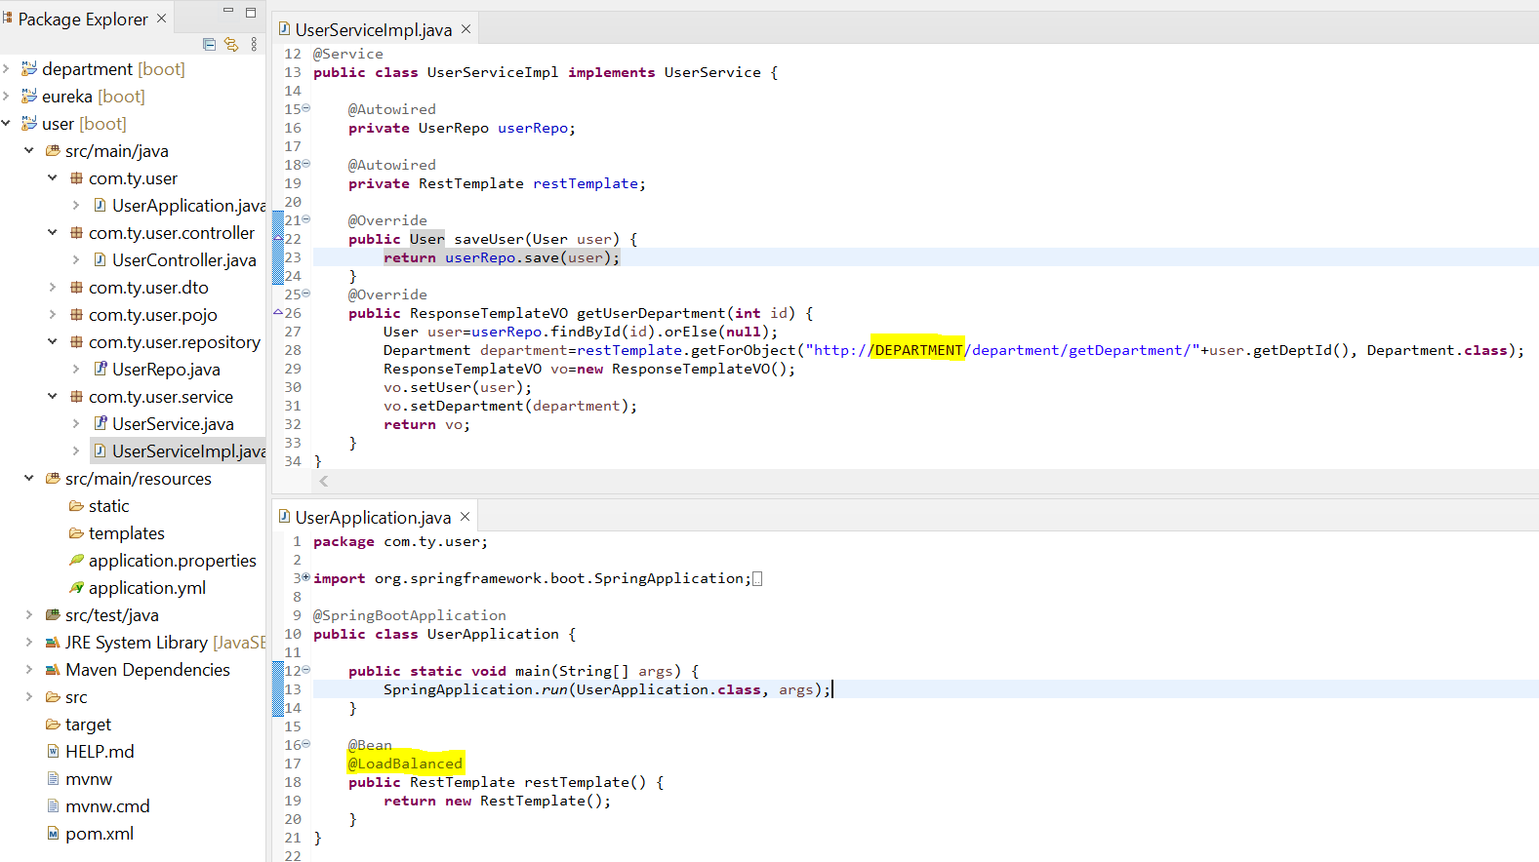
configure Service 2 with Eureka Server

Slide 21
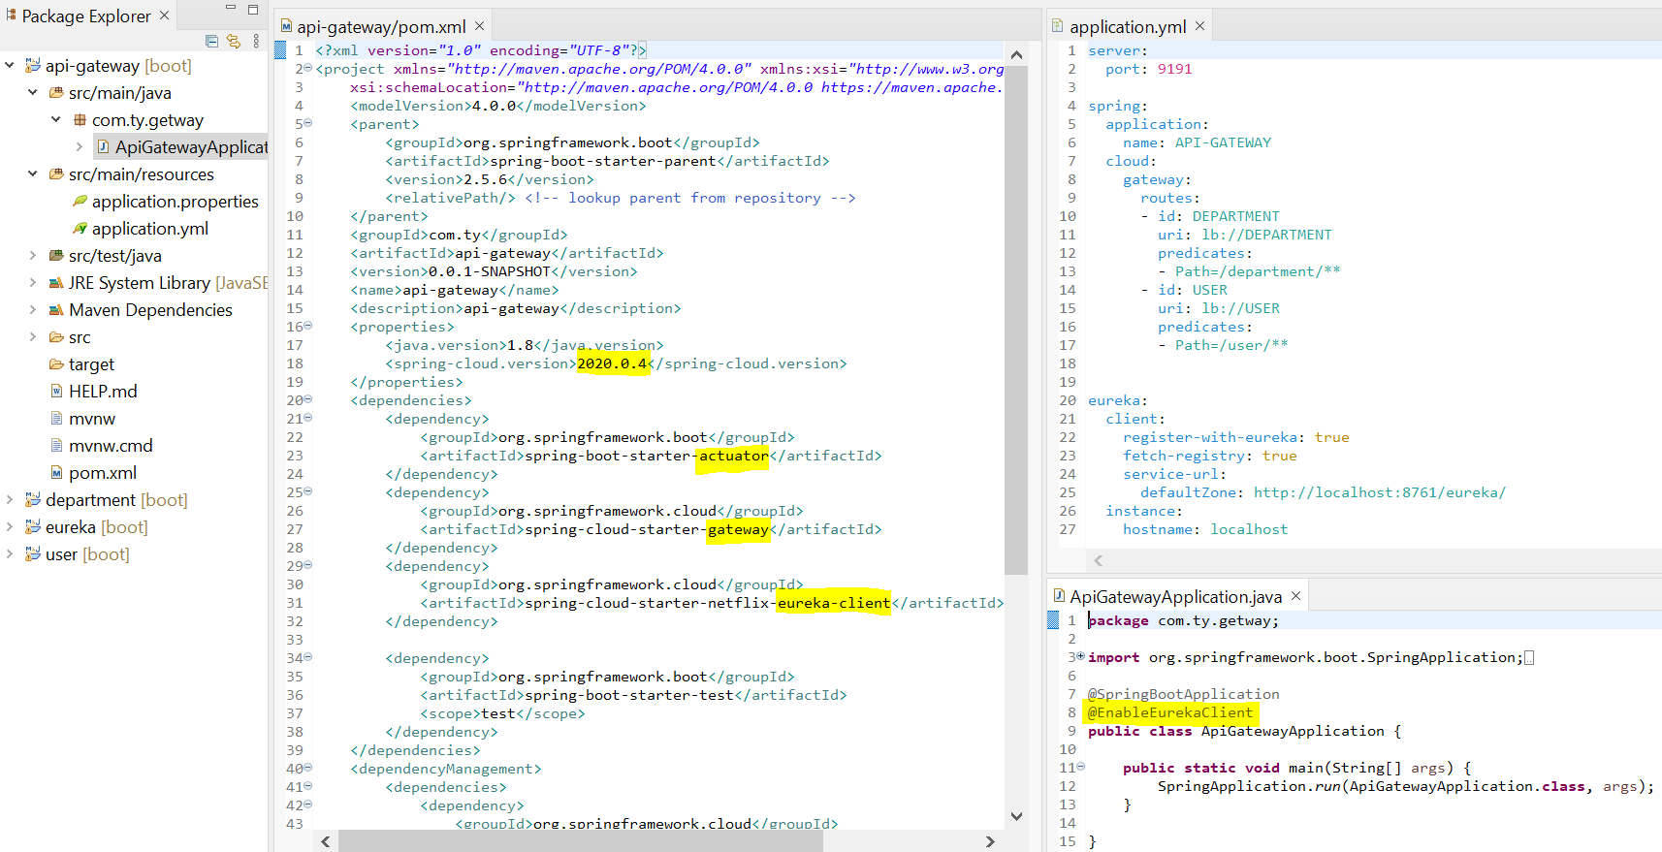
service 4 api gateway

Slide 22
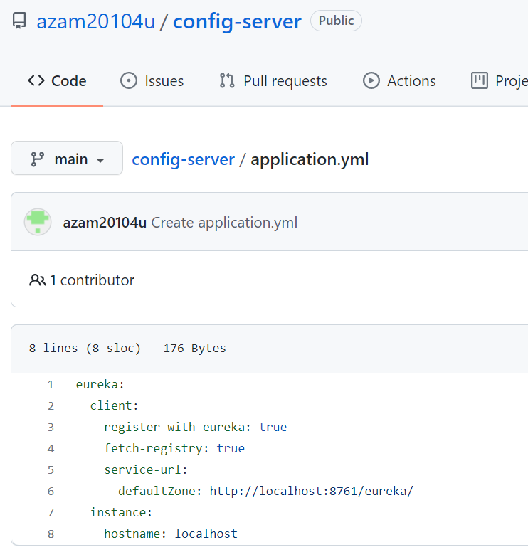
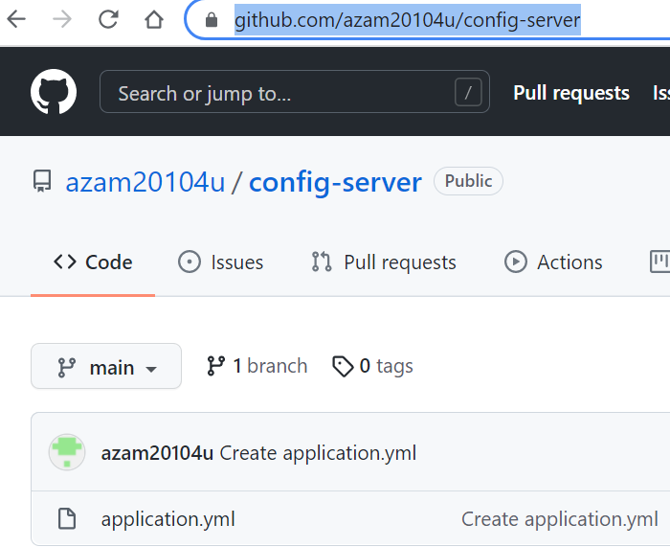
service 5 (i.e config-server)
Go to your github account and create a new repository, create a new file by the application.yml and copy all the common configuration and past it over here. save it and copy the url

Slide 23
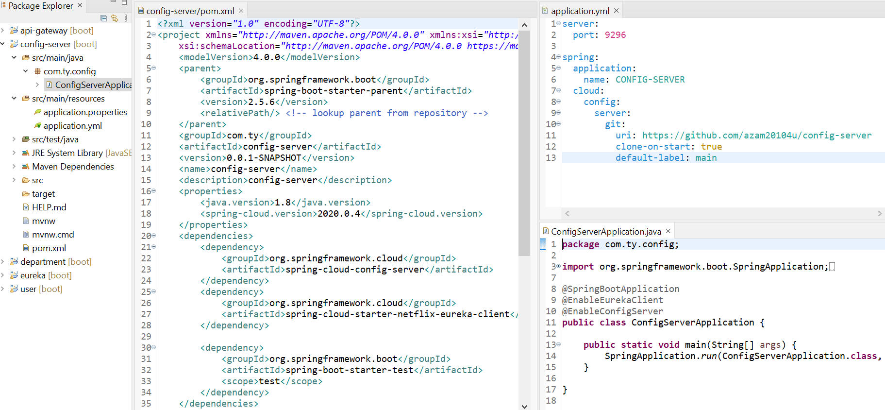
service 5 (i.e config-server)

Slide 24
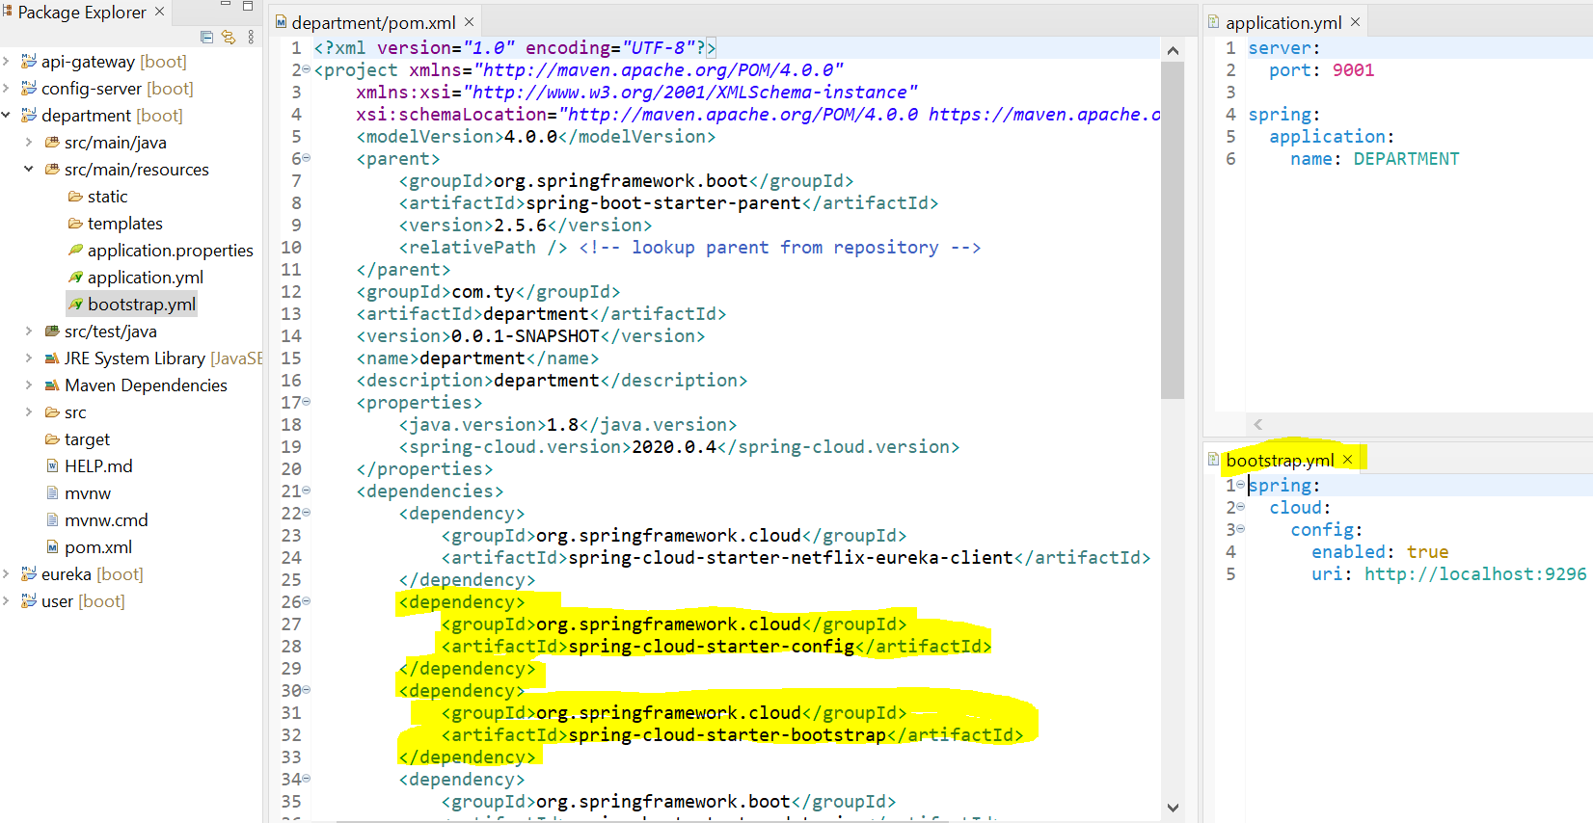
now on each service configure accordingly

Slide 25
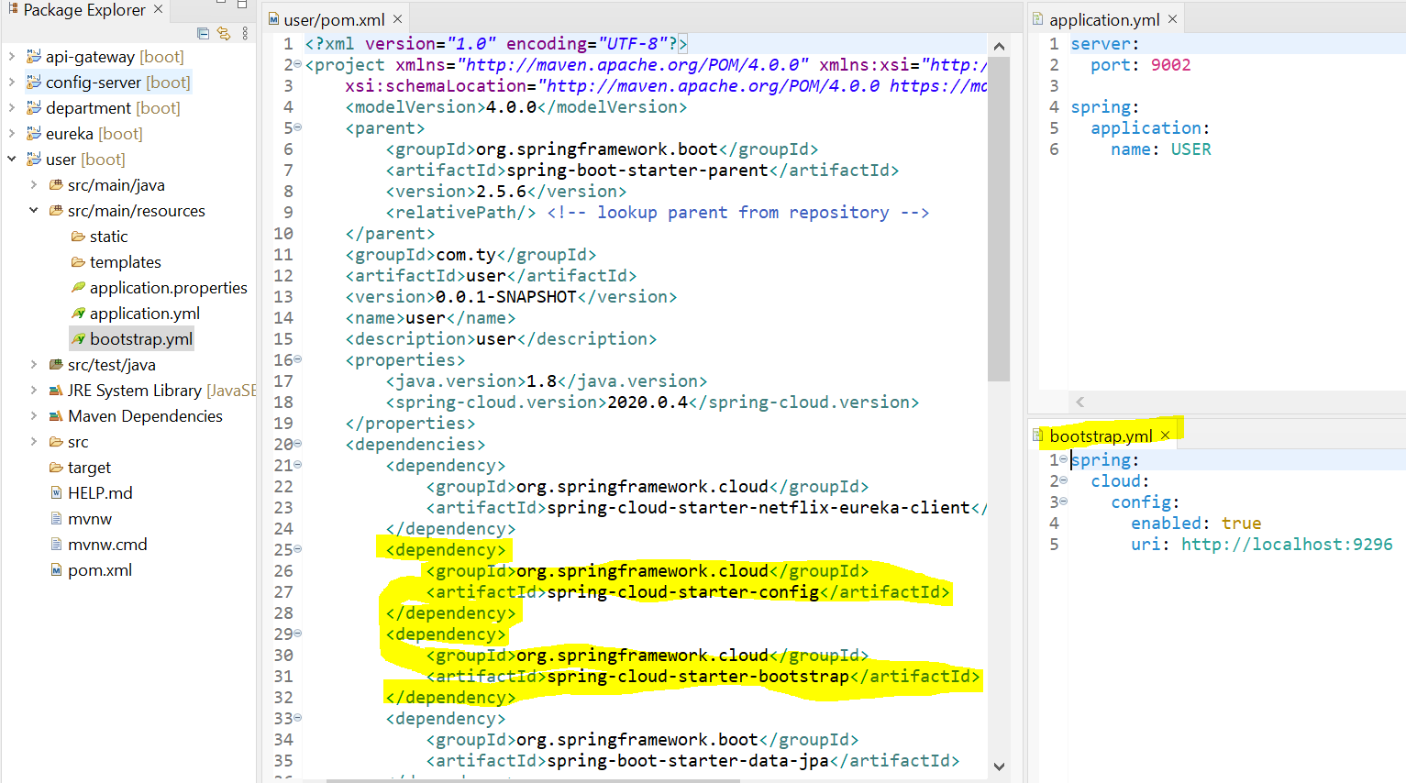
now on each service configure accordingly

Slide 26
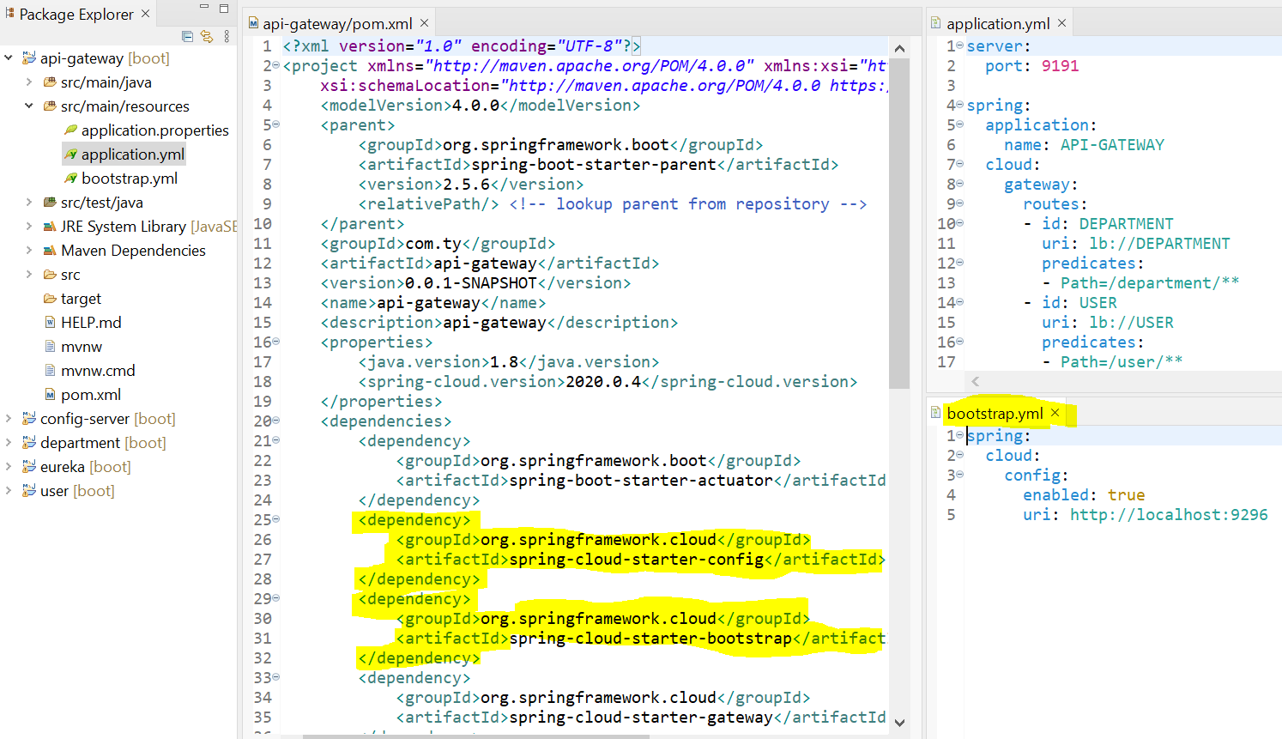
now on each service configure accordingly

Slide 27
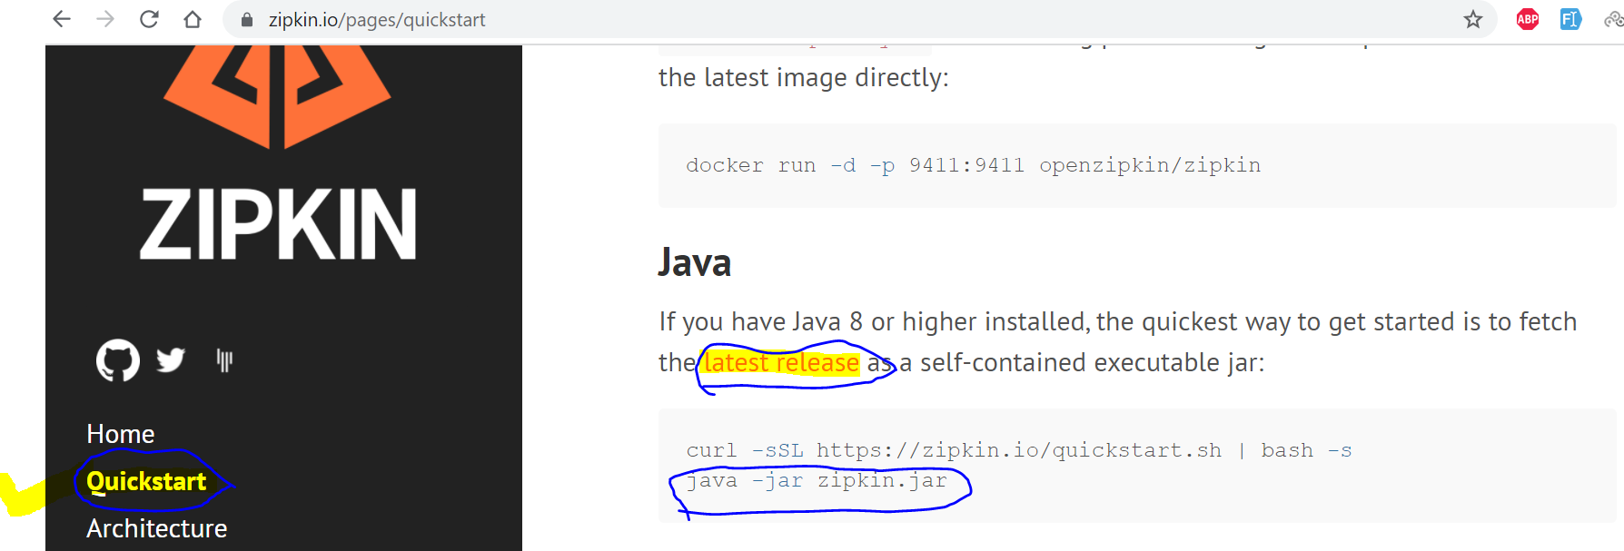
Zipkin and Sleuth
Download Zipkin jar file and run by java cmd for simplicity but recommended is docker

Slide 28
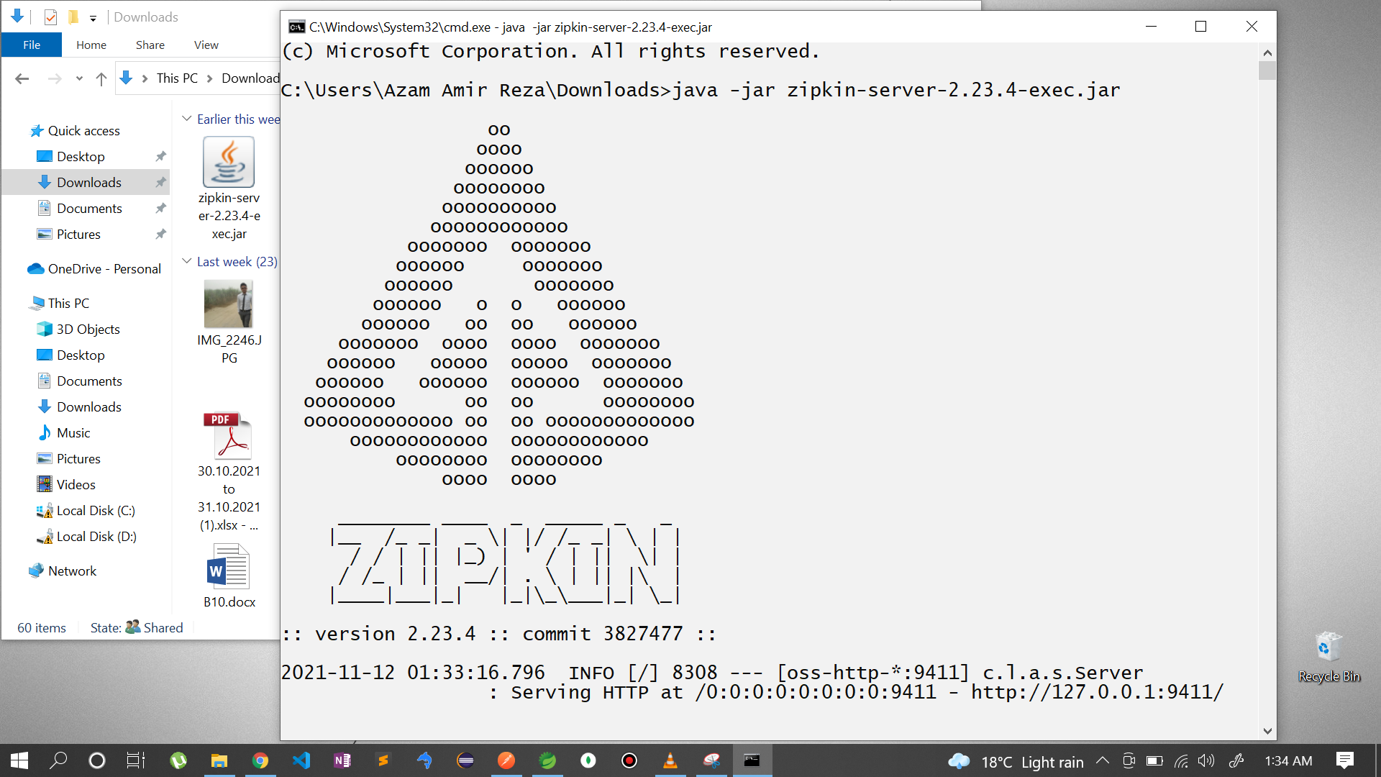
Zipkin and Sleuth
Now go to download file open cmd and run this command and start the zipkin server

Slide 29
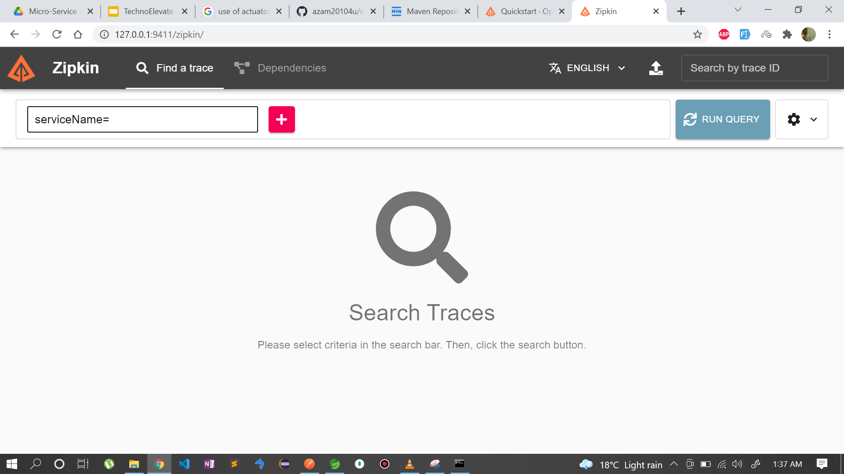
Zipkin and Sleuth
Now go to your browser, past the url. as of now there are no service available to trace

Slide 30
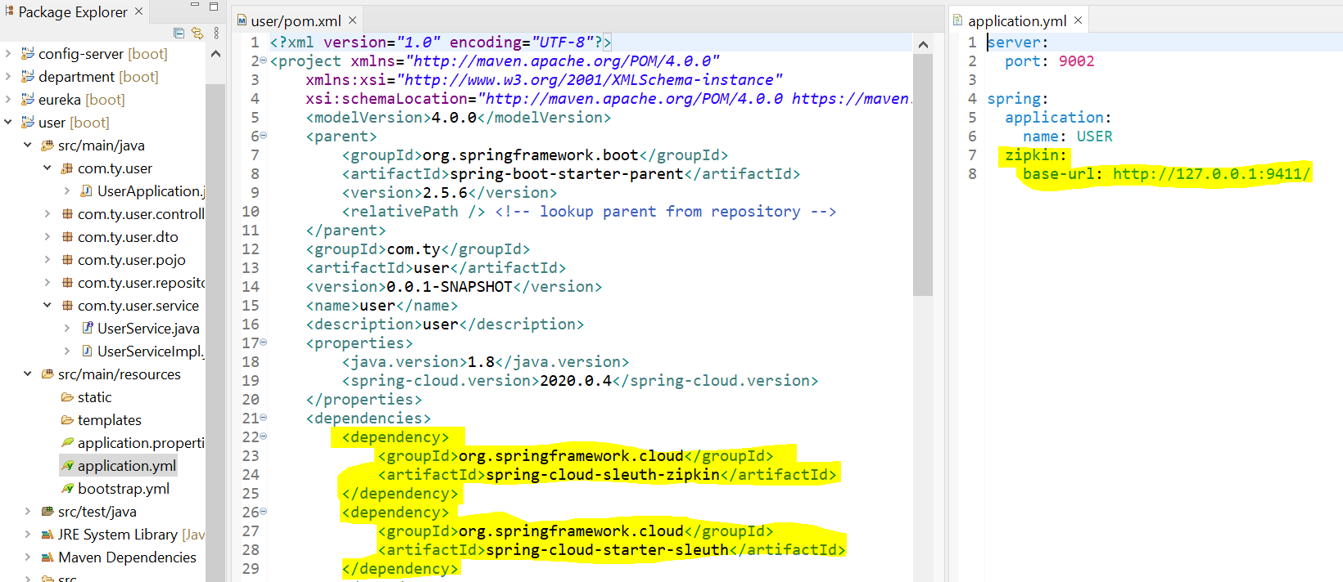
add dependency and configure all the services( user, department)

Slide 31
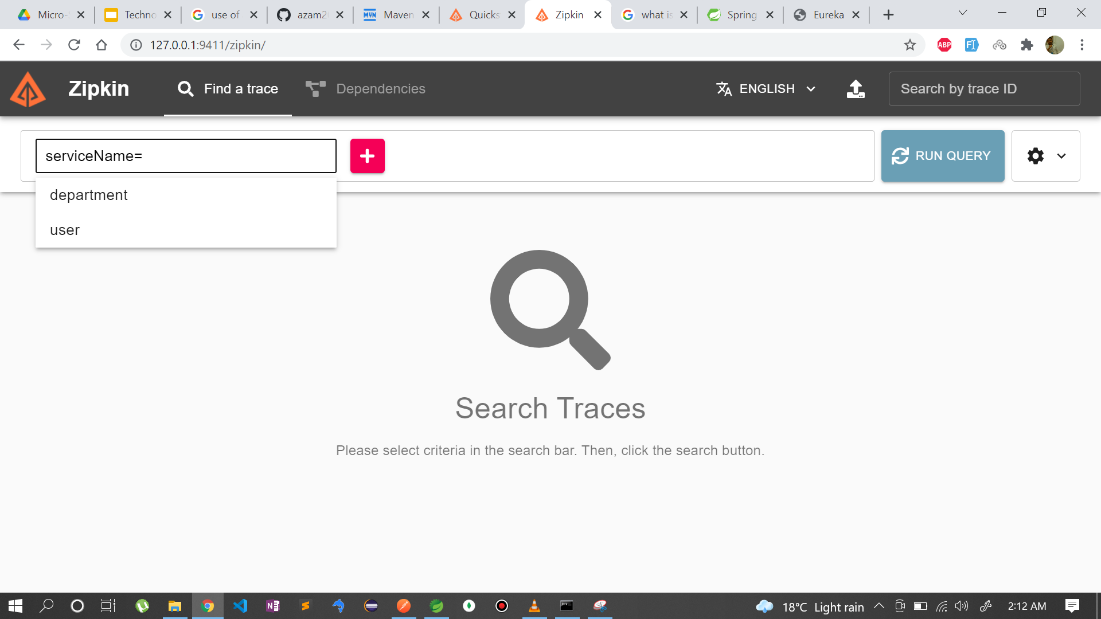
Zipkin and Sleuth
Now go to browser open zipkin server check services and their trace id

Slide 32
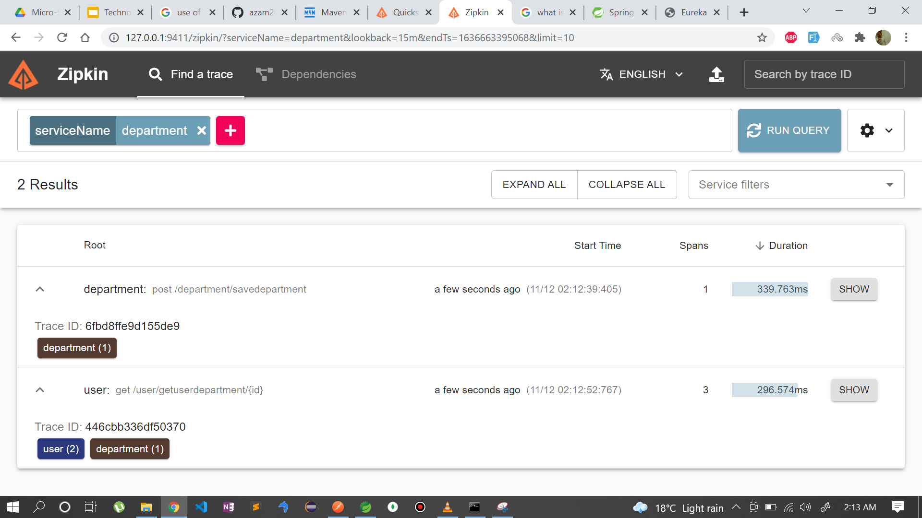
Zipkin and Sleuth
Note: to see this comment Circuit breaker and fallback method time being

Slide 33
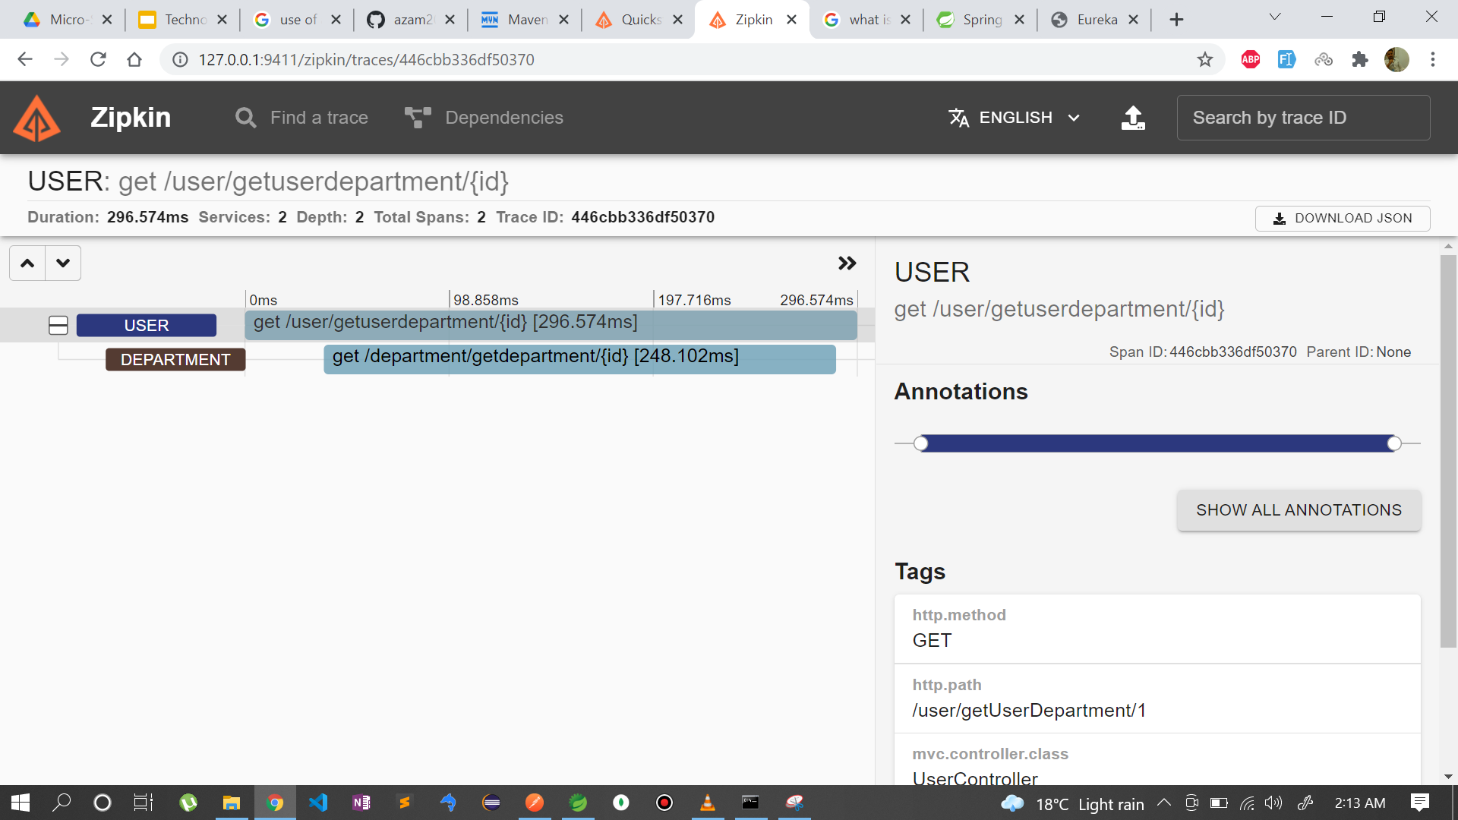
Zipkin and Sleuth

Slide 34
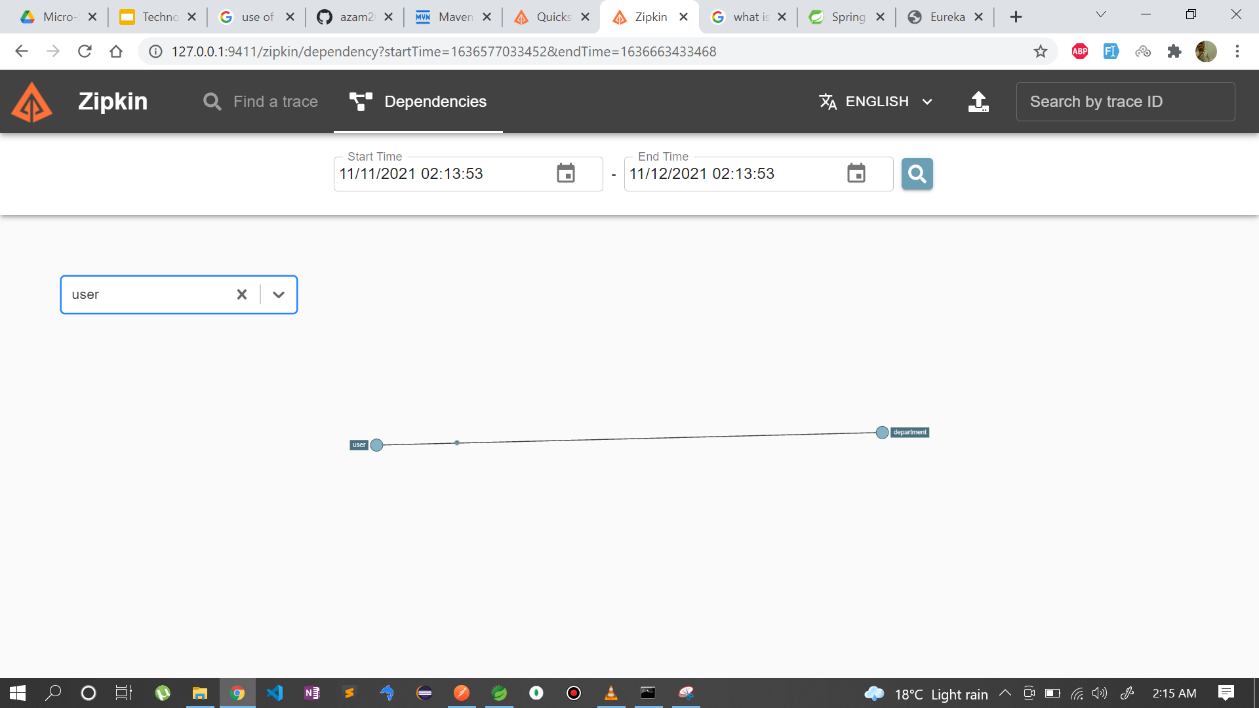
Zipkin and Sleuth

Slide 35
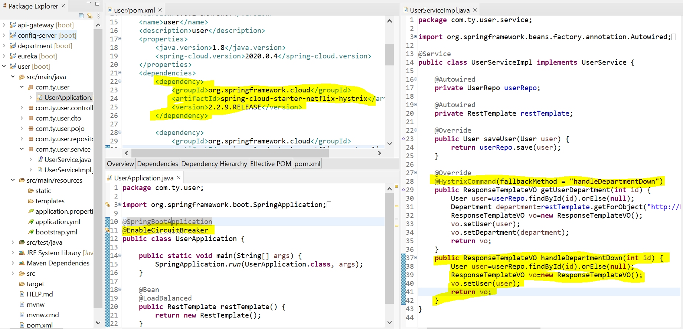
Circuit breaker with fallback method

